Slide 1
CSEC 280
What is the purpose of this course?
Basic security approach is defense in depth
Notes:
An INTRODUCTION defense course to get you thinking
What is defense in depth? Why?

Slide 2
Security Fundamentals
The Information Security Cycle
Information Security Controls
Authentication Methods
Cryptography Fundamentals
Security Policy Fundamentals

Slide 3
What Is Information Security?
Protection of assets
Protection of available information or information resources.
Necessary for a responsible individual or organization to secure confidential information.
Minimize business risks and other consequences of losing crucial data.
Note:
The foundation of Information Security is Risk management (2014: 97% of companies using network defenses get hacked anyways)
Notes:
Mine: Prevention of adverse consequences from the actions of others
Same accidental or intentional, human or natural

Slide 4




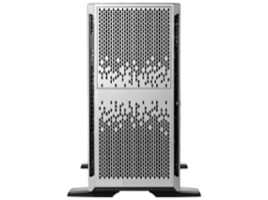

What to Protect
Data
Bank
Account
Numbers
Data
SSNs
Resource
Data
Resource
Notes:
Data: Just electronic? Backups, paper
Why resources? Just buy a new computer?
Consider equipment, time, buildings/desks/etc., PEOPLE (most important)
Collateral damage: reputation, loss of good will, loss of customers, etc.

Slide 5
Goals of Security
Prevention
Detection
Recovery
Notes:
See my notes on this. Include examples

Slide 6



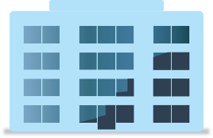


Risk
Likelihood: Rare
Damage: Moderate
Disgruntled Former Employees
Threat of Improper Access
Exposure to the chance of damage or loss
Notes:
Mine: How likely it will happen. Likely hood
Risk is the determining factor when looking at security
See page 3 for example DON’T go to in depth this is covered in LO 8

Slide 7
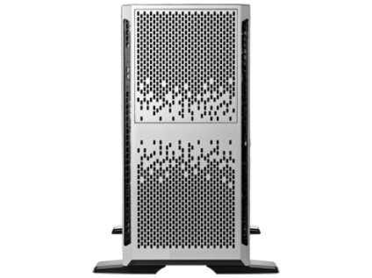








Threats
Intentional or unintentional
Information Security Threats
Changes to Information
Interruption of Services
Interruption of Access
Damage to Hardware
Damage to Facilities
Event or action that could potentially cause damage to an asset.

Slide 8
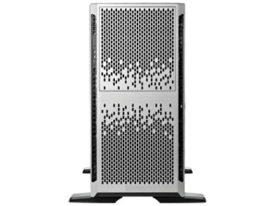

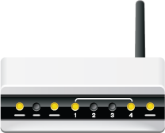


A Vulnerability
Attacker
Unsecured Router
Information System
Any condition that leaves a system open to harm
Notes:
A weakness
A threat will exploit a weakness
Page 5 for a list

Slide 9
What is Risk Management then?
A mix of risk, value and vulnerability
High Security
Value
Low Security
Risk (Likely hood)
Plot a point for each vulnerability to determine security effort
Notes:
DON’T go to in depth, this is covered more in LO8 Go into Understanding Risk Management in my notes Page 2

Slide 10



Intrusions
When an attacker accesses a system without authorization
Notes:
What is authorization??

Slide 11


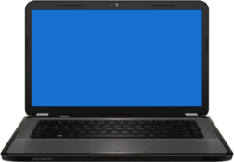
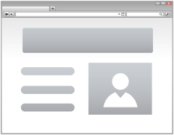

Attacks
A technique used to exploit vulnerabilities
Physical Security Attacks
Software-Based Attacks
Social Engineering Attacks
Web Application-Based Attacks
Network-Based Attacks
Notes:
How is an attack different from intrusion? The intrusion is the doing, the attack is technique. They are used interchangeably however
*********We will talk more about attack ers in LO2

Slide 12

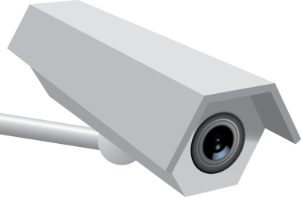



Controls
Controls are the countermeasures that you need to put in place to avoid, mitigate, or counteract security risks due to threats or attacks.
May be applied for EACH threat identified
Prevention Control
Detection Control
Correction Control
Notes:
Solutions
Security is about tradeoffs. Security vs usability. Talk about locks here, hard to duplicate keys as well as personal banking vs online

Slide 13
Types of Controls
Prevention
Take measures to prevent assets from being stolen or damaged
Detection
Take measures to detect (notice) when an asset has been damaged, how and who
Correction (reaction)
Take measures that allow you to recover your asset or recover from the damage to the asset

Slide 14
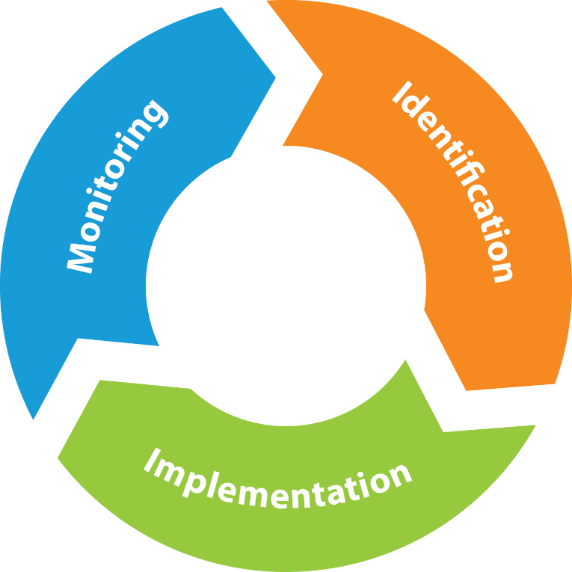
The Security Management Process
Notes:
This is not a one time thing. Done over and over, we will see this more later

Slide 15
Security Controls
Identify : Determine the problems and how best to protect a system
Find out when and where breach occurred
Log details (failures and successes)
Select IDS (Intrusion Detection Systems)

Slide 16
Security Controls
Implement: Involves installing mechanisms to prevent problems
Authenticate users
Match controls with management requirements
Install IDS or IPS (intrusion Prevention System)
Maintain business model or needs

Slide 17
Security Controls
Monitor: Detect security issues AFTER controls are implemented
Run tests/simulations on controls to see if they are effective
Analyze steps to improve
Document

Slide 18



The CIA Triad
Integrity
Confidentiality
Availability
Notes:
More on next slides

Slide 19
Availability
Ensuring the system operates continuously and that authorized people can access it
Methods:
Redundancy
Fault Tolerance
Backups

Slide 20
Confidentiality
Keeping information and communication private and protected from unauthorized access
Methods:
Encryption
Access control
Steganography (??)
Policies

Slide 21
Integrity
Keeping information accurate, free of errors and without unauthorized modification
Methods:
Hashes
Digital Signatures
Certificates
Non-repudiation
Notes:
To me this is THE most important. Why?

Slide 22

Non-repudiation
Non-repudiation
Non-repudiation: is the assurance that someone cannot deny something. Typically, nonrepudiation refers to the ability to ensure that a party to a communication cannot deny the authenticity of the sending of a message that they originated. Proof of data integrity

Slide 23


Identification
Identification
Identification is ensuring an entity requesting access to resources is the true owner of the credentials. How much effort is put into this depends on the degree of security that is needed for the resource
Notes:
Very similar to authentication (next slide).

Slide 24

Authentication
Authentication is the method of validating credentials.
Notes:
Often identification and Authentication are used interchangeably but technically authentication is a method and identification should be a part of that

Slide 25

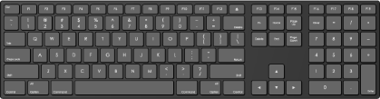
Authentication Factors
Something you are
Fingerprints, handprints, or retinal patterns
Something you have
Key or ID card
Something you know
Password or PIN
Somewhere you are or are not
IP address or GPS
Something you do
Keystroke patterns
Password
24.213.151.4
Notes:
We will discuss these more a bit later
Best practice is to use 2 form factor

Slide 26
Authorization
Determining the rights and privileges of a user or entity.
Comes after identification and authentication.

Slide 27
Access Control
Determining and assigning privileges to resources, objects, or data.
Manages authorization.

Slide 28


Access Control Models
Mandatory Access Control (MAC)
Discretionary Access Control (DAC)
Role-Based Access Control (RBAC)
Rule-Based Access Control
Notes:
MAC: Compare objects security designation to users clearance. Designation is set for each object NOT user. Ex a file is top secret. If you are also top secret you can see it
DAC: Each object has a list of users rights (ACL)
RBAC: Users are assigned roles and an object allows only certain roles to access it. Similar to MAC
Rule based: Much like a firewall or time access. Typically set for everyone.

Slide 29
Accounting and Auditing
Accounting: The process of tracking and recording system activities and resource access.
Auditing: examine what was recorded.
Notes:
Auditing is the catch all term people use
Talk about the AAA concept here.
Authentication, authorization, accounting

Slide 30
Common Security Practices
Implicit deny
Least privilege
Separation of duties
Job rotation
Mandatory vacation
Time of day restrictions
Privilege management
Notes:
*************Covered in next slides

Slide 31


Implicit Deny
Default Deny
Read Access Granted
Write Access Denied
Everything that is not explicitly allowed is denied
Notes:
Talk about how Microsoft used to default to everyone full controll

Slide 32





Least Privilege
Perform their jobs with fewer privileges
User 1
User 4
Perform their jobs with more privileges
User 2
User 3
Data Entry Clerks
Financial Coordinators
Users and software should have minimal levels of access to perform duties.
Privilege Bracketing is when privileges are given out only when needed and revoked after
Notes:
Why should a screen saver have system privileges?
Should an administrator use their admin account all the time? Can “run as admin” when needed

Slide 33

Separation of Duties
Backup
Audit
Restore
No one person will have complete power or knowledge.
Notes:
Prevent ethical conflict or abuse such as approving a project that benefits you or buying your software
Missile launch codes and keys
Costco lockup

Slide 34


Job Rotation
Backup
Access Control
Audit
Firewall
Restore
Ensures no one person becomes to valuable.
Notes:
Ensures redundancy
Allows others to check your work
Prevents boredom (lifeguards)
Enhances professional skills

Slide 35
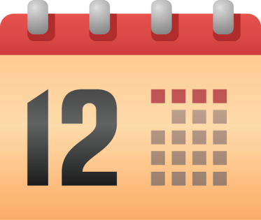
Mandatory Vacation
Provides an opportunity to review employees activities.
Notes:
Several days of uninterrupted time to review audits etc.
When employee KNOWS this the chance of fraud decreases

Slide 36
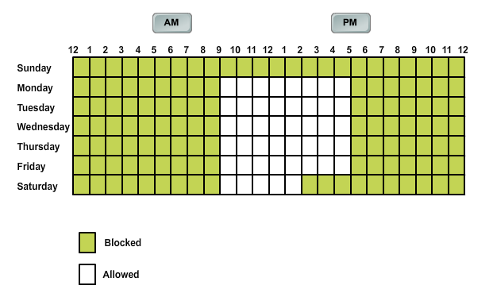
Time of Day Restrictions
AM
PM

Slide 37
Orphaned Accounts
User accounts that remain active after the employee has left

Slide 38


Privilege Management
Accounting/Auditing
Authorization
Access Control
Administrator
Authentication
Use authentication mechanism to administrate user and group control. Should have auditing and privilege escalation abilities. Single sign on is a common characteristic

Slide 39

Authentication Methods
Remember Identification and authentication is often used interchangeably

Slide 40
User Name/Password Authentication
Password
User name
An example of what you know
Notes:
Should username be secure?
Is a password really secure?
We will look at password cracking later

Slide 41

Tokens
Unique Value
PIN
User Information
Password
Usually a physical object, a what you have
Notes:
Talk about RSA ID and PayPal

Slide 42
Biometrics
Fingerprint Scanner
Examples of what you are
Notes:
Go into discussion of various biometrics

Slide 43
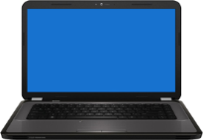
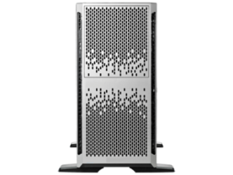


Geolocation
Where you are or are not.
Determines physical location from IP address, MAC address, RFID, GPS coordinates, etc.
Authentication requests from approved locations are granted.
Authentication Approved
Authentication Request
Approved Locations
Authentication Denied
Notes:
Could be a specific computer, IP, call back number, etc.

Slide 44


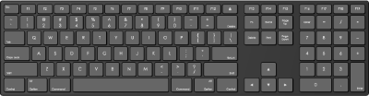
Keystroke Authentication
Keystroke Pattern Detector

Slide 45

Multi-factor Authentication
Password
ID Card
2 or more authentication factors. 2 of who you are, what you have and what you know

Slide 46
Mutual Authentication
Each party in the communication must authenticate themselves
Notes:
Your bank : they have a certificate and you have a password
Helps avoid man in the middle and session hijacking attacks

Slide 47
Cryptography
G7JDZL L539CZ AA9CZ1
ZPQ12G 93L12B LP7FFH
18ABHU UJ14A9 334FYO
K71TYP CS3314 566HHX
SAPRW1 SP563S 3F8Y0K
PVF129 A7V8TT ADL10M
N031M1 LAE3FB 1L598X
RX0FYT LM2HU5 GT610A
I5581Z QH1UNB 9JB70W
Notes:
Is used a lot : password storage, sending data, securing files, digital signatures, etc.

Slide 48



Encryption and Decryption
Plaintext
Encryption
Ciphertext
Ciphertext
Decryption
Plaintext
Plaintext
Notes:
Ciphertext is encrypted text

Slide 49

Ciphers
Original Information
Cipher
Encrypted Information
An algorithm used to encrypt and decrypt data. The application of a cipher is the encryption and it produces ciphertext
Cryptoanalysis or Cryptanalysis is the science of breaking codes and ciphers
Notes:
A cipher and code are technically different. A cipher is one for one were a code is for words or phrases.

Slide 50
Cipher Types
Stream Cipher
Plaintext
Cipher
Ciphertext
Block Cipher
Plaintext Block
Cipher
Ciphertext
Block
Notes:
Stream : one bit at a time. These produce the same size of text, fast, low overhead, low error rate and an error only affects 1 bit
Block : typically 64 bits at a time and is more secure

Slide 51
Encryption and Security Goals
Confidentiality
Integrity
Non-repudiation
Authentication
Access control
Notes:
Maybe mention EFS (go into detail later), bit locker and IPV6 (IPSec) here very briefly

Slide 52

Steganography
Steganographic techniques include:
Hiding information in blocks.
Hiding information within images.
Invisibly altering the structure of a digital image.
Vessel Image
Steganographic Image
Secret Data
Notes:
They now have this for sound files and video as well
Can be used as a type of watermark too. Some printers hide dots with serial numbers and time/date stamps

Slide 53
A Key
Original Information
Cipher
Encrypted Information
= Two Letters Following
Notes:
When a different key is used with the same algorithm it produces different ciphertext

Slide 54
Keys
Keys can be:
Static: Intended for relatively long time use
Ephemeral: Generated for individual communication sessions or even segments
Notes:
WIFI encryption can use a different key every few packets for example

Slide 55
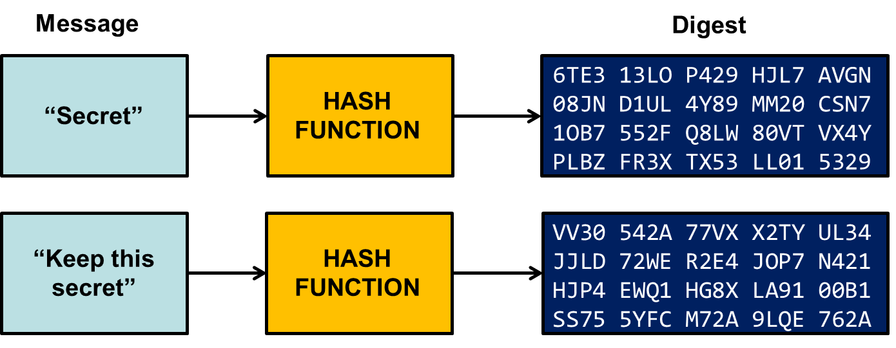
Hashing Encryption
A one way encryption that is NOT intended for decryption. The resulting ciphertext is called a hash, hash value or message digest. The input data can vary in length but the hash length is fixed by the algorithm.
Notes:
Password storage
File integrity
Transfer integrity
In THEORY any little change will produce a different hash

Slide 56
Hashing Encryption Algorithms
MD5
SHA
NTLM versions 1 and 2
RIPEMD
HMAC
Notes:
Page 33 The book has a bit about each of these could list some basics if you want
MD5 is no longer considered safe
SHA256 not safe un less salted :
A new salt is randomly generated for each password. In a typical setting, the salt and the password are concatenated and processed. The resulting output (but not the original password) is stored with the salt in a database. If you use the same salt for each password it is less effective Maybe talk briefly about rainbow tables here

Slide 57
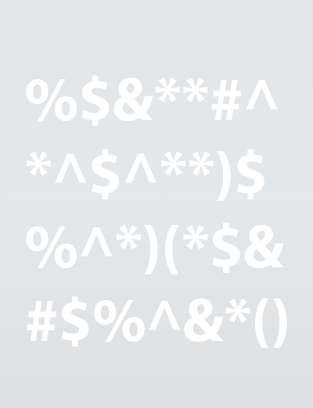
Symmetric Encryption
Encrypts Data
Decrypts Data
Same Key on Both Sides
Notes:
Fast (orders of magnitude, 10,000 some times) Why might this be important? Large files
Must get key to other system
What if key is lost?

Slide 58
Symmetric Encryption Algorithms
DES
3DES
AES
Blowfish
Twofish
RC 4, 5, 6
Notes:
Page 35

Slide 59

Asymmetric Encryption
Public Key Encrypts
Private Key Decrypts
Often called public key encryption and uses certificates as the keys. The keys are based on VERY large prime numbers
Notes:
Explain how Only private decrypts public but public decrypts private. Why? Digital signature covered later.
Slow
Often used to exchange a one time symmetrical key
Talk about EFS and multi users/recovery agent

Slide 60
Asymmetric Encryption Techniques
RSA‏
DH
ECC
DHE
ECDHE
Notes:
Page 36

Slide 61

Key Exchange
Sender
Receiver
For messages to be exchanged, the sender and receiver need the right cryptographic keys
Symmetric cipher: Same key
Asymmetric cipher: Each other’s public key
In Band : The key and data are sent using the same path of communication
Out of Band : use different paths
Notes:
In band : wi fi, internet
Out of band : sent by mail or by phone, physical transfer or asymetrical

Slide 62


Digital Signatures
Hash Value of Signature
Hash Value Matches
Notes:
Using public/private keys to verify it is you. Encrypt with private and any public can decrypt
Often attach an encrypted hash of message to the end. Why an encrypted hash? Encryption for identification (non-repudiation) and hash for integrity

Slide 63
Cipher Suites
Collections of symmetric and asymmetric encryption algorithms:
Key exchange
Bulk encryption
Message authentication code
Pseudorandom function
Establish secure connections between hosts.
Associated with TLS and SSL network protocols.
Over 200 named cipher suites provide varying protection levels.
Key Exchange Algorithm
Bulk Encryption Algorithm
Message Authentication Code Algorithm
Pseudorandom Function
Cypher Suite
Notes:
Page 38

Slide 64
Session Keys
Single-Use Key
Related Messages
Sender
Receiver
Unrelated message requires a different key
Single use key used in symmetrical encryption used for all messages in a single series
Notes:
Why a different key for each session?
If key keeps changing, harder to crack
The less often the asymmetrical key is used the less likely it will be cracked
Faster then asymmetrical

Slide 65
Perfect Forward Security
The property of a public key system that ensures that any session keys derived from a long-term key cannot be compromised if a future key is compromised
A key that is used can not be used to compromise any other key (past or future)
Only the data encrypted with that key will be vulnerable
Examples are:
DHE (Diffie-Hellman Exchange)
ECDHE (Elliptical Curve DHE)

Slide 66
Key Stretching
Original Key
Key Stretching Algorithm
Enhanced Key
Key stretching makes it harder to crack passwords and passphrases.
A method of taking a weak key such as a password increasing the number of bits.
Notes:
Repeated looping hash function (may use the original over and over or the new one is the key for the next)
Repeated looping block cipher
A key schedule that breaks or calculates a big key into subkeys to encrypt each section of data

Slide 67
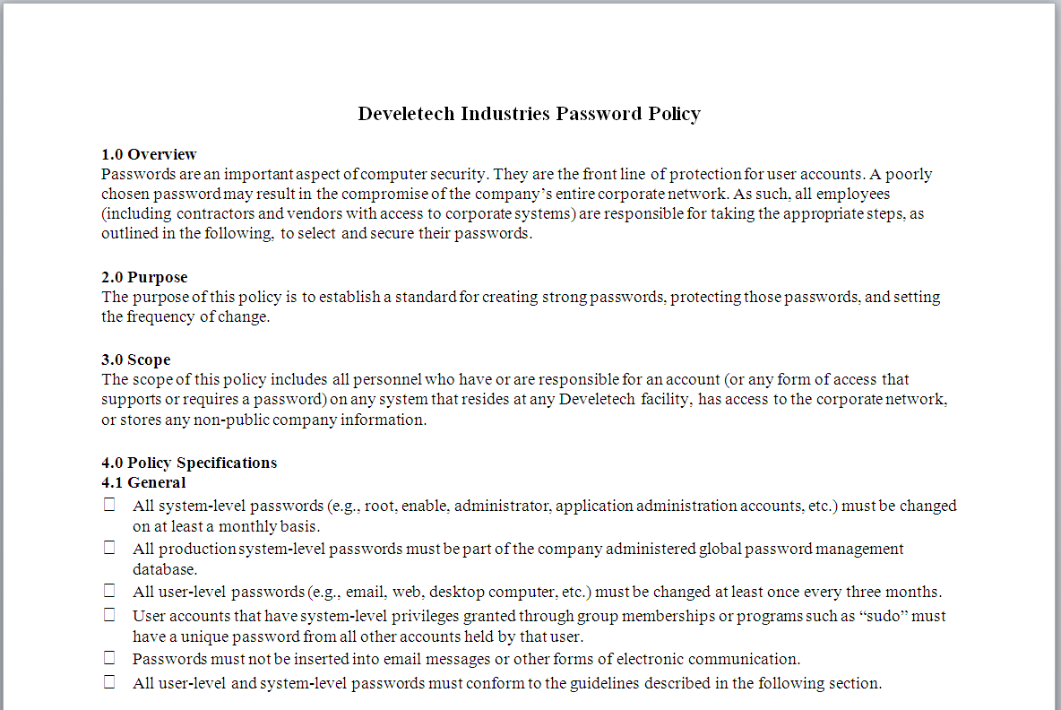
A Security Policy
Individual Policy
Resources to Protect
Formal Policy Statement
Implementation Measures
A formalized statement that defines how security will be implemented
Notes:
Lots of documents

Slide 68

Security Policy Components
Policy statement
Standards
Guidelines
Procedures
Notes:
Policy statement : Outlines the plan for each component
Standers : How to measure the level of adherence
Guidelines : Best practice of how to meet the standard
Procedures : Step by step

Slide 69
Common Security Policy Types
Acceptable Use Policy (AUP)
Privacy policy
Audit policy
Extranet policy
Password policy
Wireless standards policy
Social media policy

Slide 70
Group Policy
A centralized account management feature for Active Directory
Notes:
This is NOT what we are talking about though it is often confused with it. We are talking about paper policies

Slide 71
Security Document Categories
System architecture
Change documentation
Logs
Inventories
Notes:
System architecture : setup/configuration of network and other infrastructure
Change documents : a way to keep things up to date. Need to be incorporated into system architecture once in a while
Logs : Specially security and audit logs
Inventories :

Slide 72
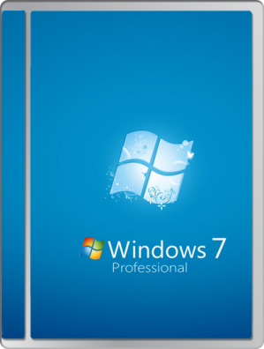


Change Management
A systematic way to approve and execute changes to ensure security, stability and availability

Slide 73


Documentation Handling Measures
Classification
Retention and Storage
Disposal and Destruction
How to handle sensitive document
Notes:
What about other sensitive stuff like old drives, backups, usb keys

Slide 74
Reflective Questions
1. Which of the basic security concepts in this lesson were familiar to you, and which were new?
2. Can you describe some real-world situations where you used basic security techniques such as authentication, access control, and encryption, or made use of a security policy?

